Slide 1
AMdEX Data sharing for societal challenges
The development of AMdEX is financially supported by the European Regional Development Fund

Slide 2
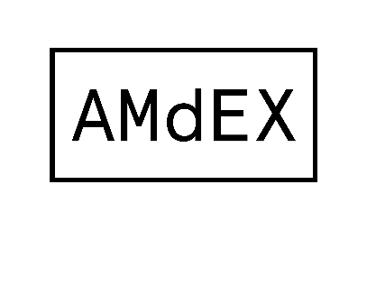
AMdEX mission
“To develop a digital notary. Offering legal contracts to organisations that want to share data. Even the most sensitive data. AMdEX translates your data-sharing agreements into machine-readable policies that can automatically be enforced. AMdEX saves you manual work, time and money.”

Slide 3
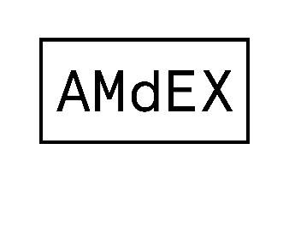
Models of innovation are changing
Innovation ecosystems
many : many
Open source movements
Collaborative
networks
Data spaces & datacommons
collaboration
1 : many
Corporate garage
Corporate Accelerator
One/off challenges
University
partnerships
Purchases from
1 : 1
startups
Tech transfer
Innovation Lab
silo
R&D
X-functional
teams
venture
builders
Acqui-hiring
plan/perfect
lean innovation
methodology

Slide 4
Notes:
Hij zag een internet voor zich van miljoenen computers, verspreid over de hele wereld. Een decentraal web, waar alles direct met elkaar verbonden was. En zo zag het er ook even uit.

Slide 5
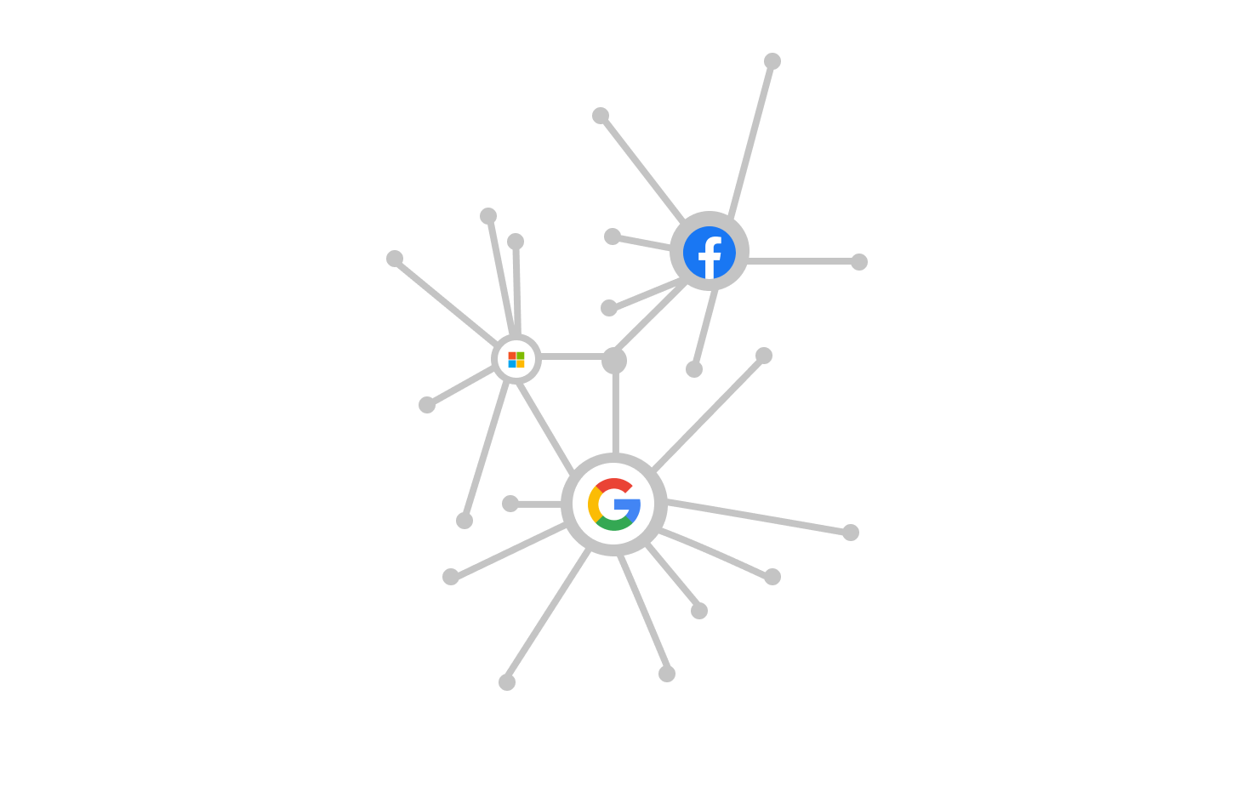
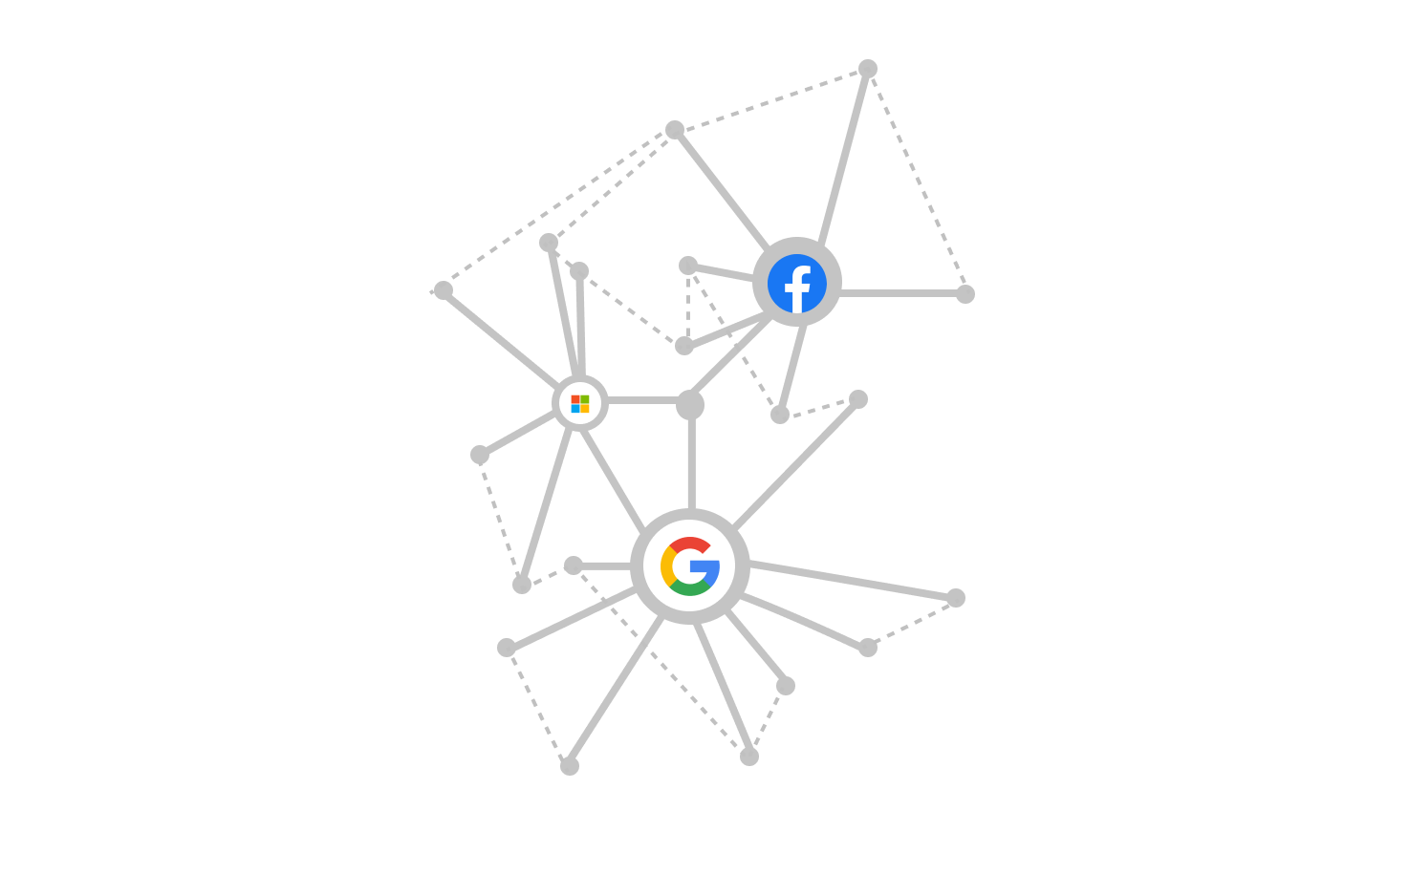
Notes:
Direct link that connect individuals and organisation have become less common and the biger hubs grew larger.

Slide 6
Notes:
Maar nu, 30 jaar later, is het web meer gecentraliseerd dan ooit. Een handjevol bedrijven heeft controle over vrijwel alle data.

Slide 7
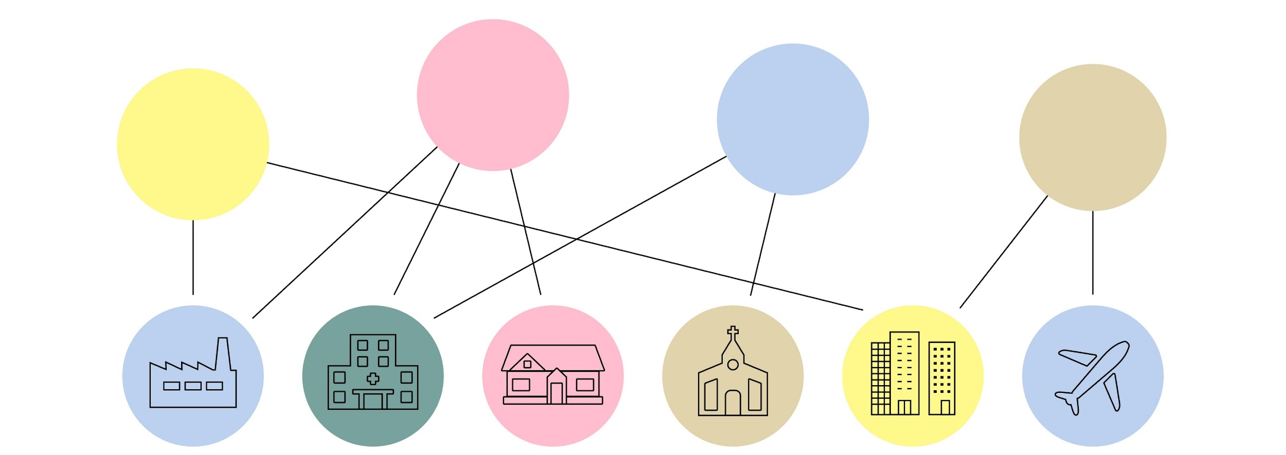
Dataspaces for innovation
Research dataspace
Health dataspace
Mobility
dataspace
Green energy
dataspace

Slide 8
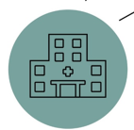
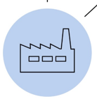

Slide 9
GDPR compliance
Data Acts compliance
Consortium agreement compliance
Ethical compliance
……

Slide 10
GDPR compliance
Data Acts compliance
Consortium agreement compliance
Ethical compliance
……
Orchestrator
Reasoner

Slide 11
GDPR compliance
Data Acts compliance
Consortium agreement compliance
Ethical compliance
……
Orchestrator
Reasoner

Slide 12
GDPR compliance
Data Acts compliance
Consortium agreement compliance
Ethical compliance
……
Orchestrator
Reasoner

Slide 13
GDPR compliance
Data Acts compliance
Consortium agreement compliance
Ethical compliance
……
Algorithm
Output
Data

Slide 14
Design questions
Who owns the AMdEX orchestrator and reasoner?
What requirements must AMdEX meet for service providers to connect to?
How do you correctly interpret laws and regulations?
What is AMdEX's governance and business model?
Notes:
De Board werkt samen met Amsterdam Science Park, UvA, VU, HvA, gemeente Amsterdam en SURF-Sara
Gebruikers hebben zelf controle hebben over hun data en over de spelregels van de markt

Slide 15
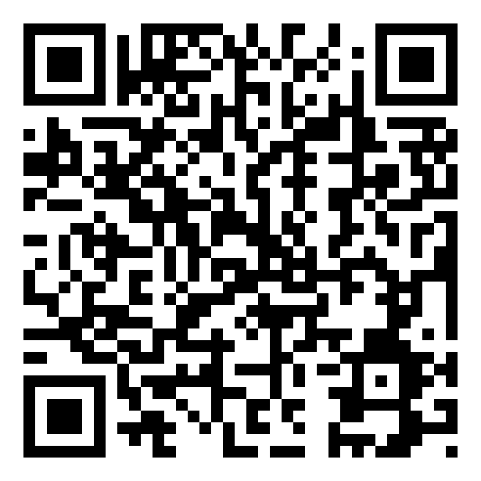
AMdEX eindejaars event

Slide 16
AMdEX partners
Open for you to join….

